Slide 1
E-Commerce Olist Exploration Data Analyst
SAEFUL AMRI

Slide 2
TABLE OF CONTENTS
01
02
03
Describing of Business
Data Preposition
04
Transform & Data Cleaning
Business Overview

Slide 3
01
DESCRIBING OF BUSINESS

Slide 4
OLIST E-COMMERCE
Olist is one of the leading e-commerce services that connects merchants to major marketplaces located and operating in Brazil. They provide a wide range of offerings, from inventory management, handling customer reviews and contacts to logistics services. This source dataset records around 100,000 orders from September 2016 to August 2018.
MISSION STATEMENT
My goal here is to perform EDA and analyze some transaction data, and sales information such as a deep understanding of buying patterns, customer preferences, and product trends to gain valuable insights.
BUSINESS QUESTIONS
How much profit was made from e-commerce and how many orders were processed?
In which year/quarter/month/day/hour was there the highest increase in sales frequency?Are there certain patterns on certain days that result in increased orders?
Which products dominate sales and generate the most profit?
What payment methods are most commonly used by customers?
Which regions/cities are the largest markets in terms of purchase volume?
Which sellers register the highest profits and sales on the e-commerce platform?
What is the average delivery time of products from order to receipt by the customer?
Is there a correlation between the length of product delivery time and the review score given by customers?

Slide 5
02
Data Preposition

Slide 6
Olist Dataset
There are 8 tables in this project where the number of rows of data in each table is different. The customer table has 5 columns 99441 rows, geolocation: 5 columns 1000163 rows, order items: 7 columns 112650 rows, orders: 8 rows 99441 rows, order payments: 5 rows 103886, order reviews: 7 rows 99224 columns, products: 9 rows 32951 columns, and category name translate: 2 rows 71 rows.
Table Customers
No | Column | Type | Description
1 | Customer_id | String | Customer ID
2 | Customer_unique_id | String | Customer unique id
3 | Customer_zip_code_prefix | Integer | Region code
4 | Customer_city | Category | Customer city name
5 | Customer_state | category | Customer state name initials
Table Geolocation
No | Column | Type | Description
1 | Geolocation_zip_code_prefix | Integer | Region Code
2 | Geolocation_latitude | Integer | Latitude coordinate point
3 | Geolocation_longitude | Integer | Longitude coordinate point
4 | Geolocation_city | Category | City name
5 | Geolcoation_state | category | Initials state name

Slide 7
Table Orders Items
No | Column | Type | Description
1 | Order_id | String | Orders ID
2 | Order_item_id | Integer | Items order ID
3 | Product_id | String | Products ID
4 | Seller_id | String | Sellers ID
5 | Shipping_limit_date | Datetime | Time
6 | Price | Float | Product category price
7 | Freight_value | float | Shipping cost
Table Orders
No | Column | Type | Description
1 | Order_id | String | Orders Id
2 | Customer_id | Integer | Customer ID
3 | Order_status | Category | Order state information (delivered, processed, canceled, etc.)
4 | Order_purchase_timestamp | Datetime | Time the customer placed the order
5 | Order_approved_at | Datetime | Time the order was approved by the seller
6 | Order_delivered_carrier_date | Datetime | Time the order was delivered to the courier
7 | Order_delivered_customer_date | Datetime | Time the order was received by the customer
8 | Order_estimated_delivery_date | Datetime | Estimated time for the order to reach the destination and be received by the customer.

Slide 8
Table Order Payments
No | Column | Type | Description
1 | Order_id | String | Orders ID
2 | Payment_sequential | Integer | If the customer pays more than once, record the order in which the customer made payments
3 | Payment_type | Category | Payment method
4 | Payment_installments | Integer | What installment the consumer pays this time
5 | Payment_value | Float | The amount of this payment
Table Order Reviews
No | Column | Type | Description
1 | Review_id | String | Review ID
2 | Order_id | String | Orders Id
3 | Review_score | Category (int) | Customer satisfaction (1 to 5)
4 | Review_comment_title | String | Title of the satisfaction survey
5 | Review_comment_message | String | Content of the satisfaction survey
6 | Review_creation_date | Datetime | Time of sending the satisfaction survey to consumers
7 | Review_answer_timestamp | Datetime | The time when the customer completed the satisfaction survey

Slide 9
Table Products
No | Column | Type | Description
1 | Product_id | String | Product ID
2 | Product_category_name | String | Product type
3 | Product_name_length | Integer | The number of words in the product name
4 | Product_description_length | Integer | The number of words in the product description
5 | Product_photos_qty | Integer | Product photos quantity
6 | Product_weight_g | Float | Product weight (gram)
7 | Product_length_cm | Float | Product length (cm)
8 | Product_height_cm | Float | Product height (cm)
9 | Product_width_cm | Float | Product width (cm)
Table Category Name Translate
No | Column | Type | Description
1 | Product_category_name | Integer | Category product names in Portuguese
2 | Product_category_name_english | Integer | Category product names in English

Slide 10
03
Transform & Data Cleaning

Slide 11
DUPLICATE
MISSING VALUE
Eliminates duplicate values
Fix/delete missing values
SPECIAL CHARACTER
REPLACE TYPE OF DATA
Change the word that does not fit
Convert dataframe to time data type

Slide 12
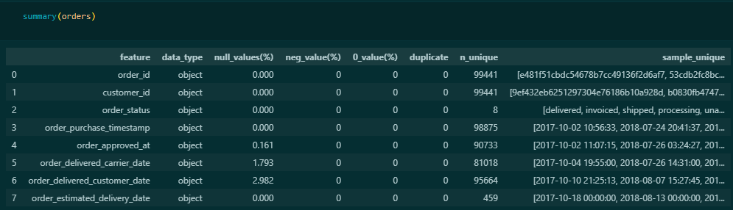
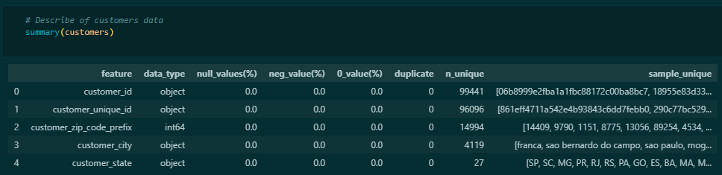
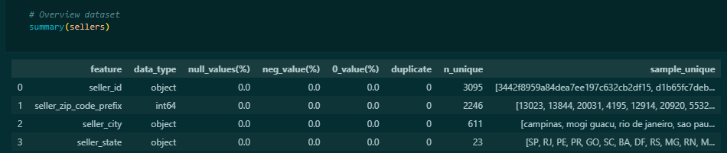
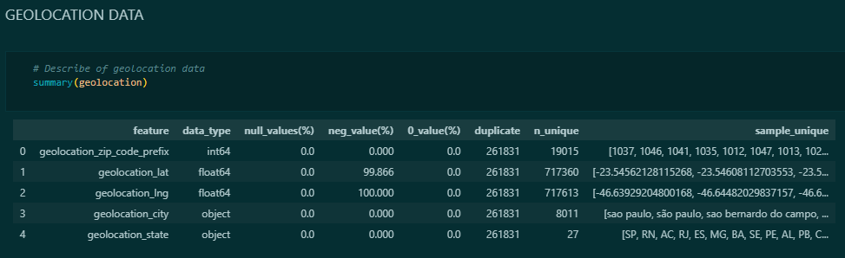
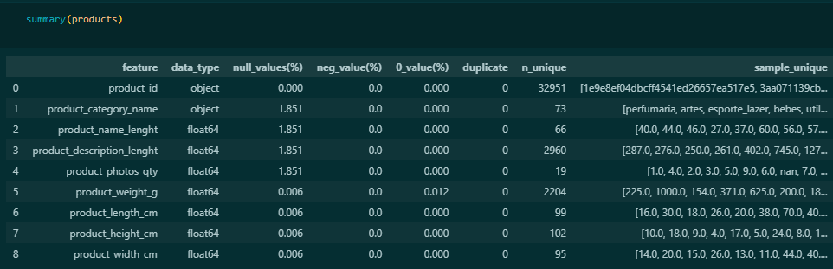
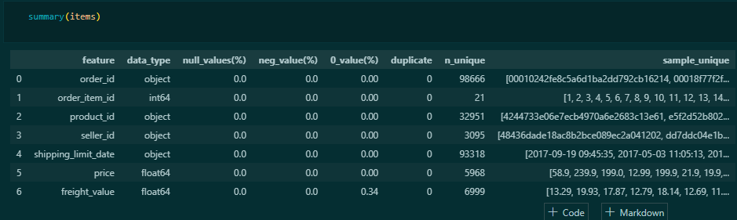
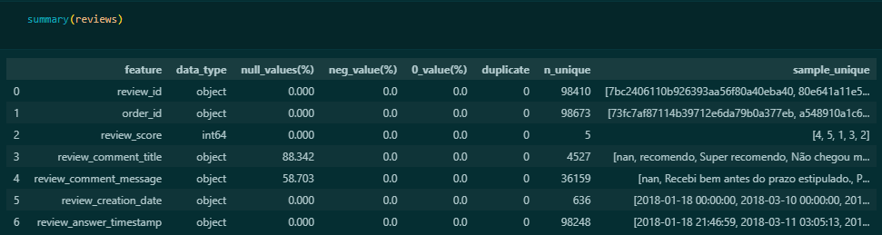
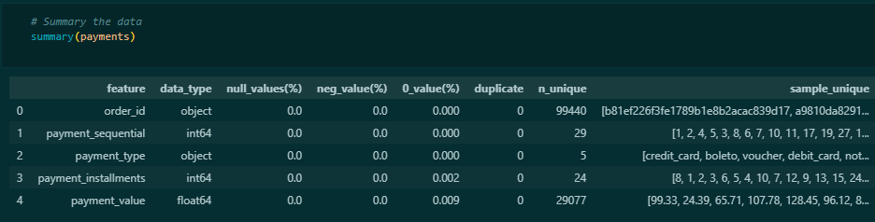
INFORMATION OF TABLE COLUMN
About colour:
Duplicate
Missing Value
Special Char
Zero Values

Slide 13
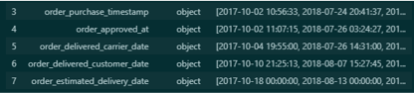
DUPLICATE & SPECIAL CHARACTER
Based on the picture above, the geolocation table has 261831 duplicate values out of 1000163 rows (about 26%). And also there seems to be a writing error that causes the value in the geolocation_city column to have almost the same unique name.
MISSING VALUE
To fix this, we will remove the duplicate values and change the special characters in the geolocation_city column.
ZERO VALUES
The zero values in the payment_installments will be drop because it is anomaly data. Minimum payment_installments is done once or worth 1 in column.
The payment_value of 0 is likely get a discount so it will be left, because when checked it goes into the payment_type voucher line.
In the prduct_weight_g will be fill based on the average value of product name that have a value of 0.
In the freight_value, this possibility get a free shipping, so it will be left.
Missing value in the product table from row 1 will be filled with the string “Unknown”, rows 2 through will be filled with the value 0, while rows 5 through 8 will be dropped.
In the reviews table, both columns will be dropped because they are almost 60% and 90%.
Missing value in the last table, the orders table, will probabily be left because it might be a canceled order.
REPLACE DATA TYPE OBJECT TO DATETIME

Slide 14
04
BUSINESS OVERVIEW

Slide 15
Based on the Olist E-Commerce, there are 8 order statuses including approved, canceled, created, delivered, invoiced, processing, shipped, and unavailable. In the EDA conducted, only based on orders that are successfully delivered.
That sales time range starts from September 2016 to August 2018.

Slide 16
15,419,773.75
96478
110197
Number of successful orders
Number of products sold
Profit earned from all sales based on successfully shipped orders.
The sum of all orders over 2 years.
Over the past two years, Olist has received a total of 98666 thousand orders with a profit of R$15422273,14 (96,478 orders) based on a record of successfully delivered orders (97,82%). The average customer made a payment of R$77,57 with the smallest being $0,0 and the highest being R$6929,31. The reason why customer pay R$0,0 is because they get a free voucher promo which results in customers not paying a penny. Meanwhile, the customer with the highest payment is because the customer ordered 21 products, making the total payment very high.
Olist orders have been increasing since December 2016, peaking in November 2017 with 7289 orders, although they fluctuated between March 2017 and July 2017. The number of orders experienced downward trend change from 7069 to 6351 from the beginning of 2018 to August 2018.
Not to much different the order data, the trend of sales data has alse increased. Items sold each month continue to increase when viewed from the beginning of orders and sales.

Slide 17
In 2016, in Q3 and Q4 only 1 order and 266 pesanan were received. In 2017 Q1 increased significantly reaching 4949, the increased continued during 2017 which in Q4 reached 17280 orders. In the first quarter of 2018, there was still an increase from the previous quarter, which received 20627 (23572 items). Subsequent quarters saw a decline in orders until the lowest reached 12510 (14105) orders in Q3.
Based on the growth index, Q4 2016 reached 26500%. This was the highest growth, in quarter 2 and quarter 3 2018 orders shrank to a low of -36.32% in quarter 3.

Slide 18
Based on daily trend, there was one day with a very high order frequency on the 24th of 2017 where there was a very drastic increase in demand, after tracing that the factor that caused a very high surge in orders was due to black Friday in Brazil.
The in 2018, there seemed to be 2 decreased in the order trend on May 26, 2018 and July 7, 2018.
Inside the box is condition where orders after black Friday. The trend on the chart looks line a seasonal trend until end of 2017. Everyone chooses to shop on Monday rather than Sunday. It can be seen from the trend that orders are decreasing towards the end of the year.

Slide 19
In 2018, the order trend was fluctuating and seasonal. On Monday, the order always get a high trend compared to Saturday and Sunday. It seems that most customer prefer to shop during the weekday compared to the weekend.
There were 2 trend lows in 2018 on May 26 and July 7. The cause of the low orders on May 26 was due to a truck driver demonstration triggered by rising fuel prices which caused food and gasoline shortages in some areas. While on July 7, there was a world cup soccer match between Brazil and Belgium held in Brazil.

Slide 20
Hour | Monday | Tuesday | Wednesday | Thursday | Friday | Saturday | Sunday
0 | 315 | 300 | 385 | 345 | 412 | 308 | 256
1 | 132 | 151 | 171 | 165 | 210 | 167 | 137
2 | 63 | 79 | 81 | 74 | 66 | 65 | 68
3 | 34 | 28 | 31 | 38 | 46 | 41 | 41
4 | 21 | 28 | 33 | 30 | 39 | 25 | 27
5 | 22 | 24 | 24 | 28 | 35 | 23 | 26
6 | 64 | 69 | 91 | 82 | 91 | 51 | 30
7 | 157 | 216 | 208 | 211 | 203 | 102 | 102
8 | 471 | 510 | 497 | 495 | 487 | 245 | 202
9 | 752 | 845 | 798 | 736 | 754 | 421 | 341
10 | 999 | 940 | 1007 | 956 | 928 | 635 | 513
11 | 1052 | 1023 | 1030 | 928 | 960 | 687 | 705
12 | 944 | 874 | 897 | 940 | 828 | 667 | 653
13 | 1000 | 1011 | 990 | 953 | 968 | 686 | 701
14 | 1063 | 1095 | 1027 | 951 | 937 | 650 | 660
15 | 1047 | 1005 | 952 | 901 | 948 | 700 | 696
16 | 1060 | 1059 | 1008 | 1042 | 943 | 676 | 688
17 | 954 | 943 | 943 | 881 | 791 | 674 | 777
18 | 891 | 852 | 818 | 759 | 697 | 693 | 875
19 | 920 | 894 | 822 | 798 | 757 | 729 | 881
20 | 998 | 946 | 881 | 816 | 714 | 708 | 944
21 | 1083 | 996 | 927 | 826 | 700 | 645 | 863
22 | 962 | 939 | 855 | 835 | 675 | 535 | 858
23 | 697 | 676 | 600 | 533 | 496 | 422 | 591
Based on the bar graph, it can be seen that people tend to shop more frequently on Mondays, Tuesdays, Wednesdays, Thursdays, and Fridays compared to weekend days (Saturdays and Sundays). The different in total orders between weekdays and weekends is not very significant.
Customers’ shopping frequency varies from 9am to 10pm. The peak of purchasing activity occurred at 2pm on Tuesday, with the number of orders reaching 1095.
It can be concluded that customers tend to shop more actively on weekdays, especially from 9am to 10pm, compared to weekends. Monday stands out as the day with the highest purchase activity, perhaps because on weekends they spend more time on recreation or vacation, their weekend time to other activities outside the home.

Slide 21
10953
Bed Bath Table
Healty Beauty
Sport Leisure
Computers Accessories
9465
8431
7644
Cds Dvds Musicals
Kitchen Laptops and Food Preparers
Pc Gamer
Fashion Children Clothers
Security & Services
14
14
8
7
2
The “Bed Bath Table” category dominated by recording 10953 sales or equivalent to 9,94% of total sales, replecting the high popularity of products in this category, This was followed by the “Health & Beauty” category with 9465 sales (8,59%), as well as the”Sports Leisure” and “Furniture & Decoration” categories with 8431 (7,65%) and 8160 (7,40%) sales respectively. Of the top 15 products, seven of them had purchases of more than 5000 or at least more 5% of total sales, such as “Computer Accessories” with 7644 purchase (6,94), “HouseHold Appliances” with purchases 6795 (6,17%), and “Watches Gifts” with 5859 purchases (5,32%)
While in the second row or red inverted triangle sign indicates less desirable product such as “Security & Services” which only sold 2 items, then “Fashion Children Clothes” product (7 item), ‘Pc Gamer’ (8 items), “Kitchen Laptops and Food Preparers” and “Cds Dvds Musicals” which get 14 items.
This can happen because there possibilities, namely Pc Gamer whose price is quite high, so not many people buy it. Then cds dvds musicals which have now been replaced by online music streaming.

Slide 22
1,412jt
Bed Bath Table
Sport Leisure
Watches Gifts
Bed Bath Table
1,264jt
1,225jt
1,118jt
Pc Gamer
Cds Dvds Musicals
Fashion Children Clothers
Security & Services
1430.10
954.99
598.67
324.51
The “Health Beauty” category ranked first with total revenue of R$1.412.089,53, followed by “Watches Gifts” with R$1.264.333,12, and “Bed Bath Table” with R$1.225.209,26. Other products included “Sports Leisure” (R$1.118.256,91), “Computer Accessories” (R$1.032.723,77), and “Furniture Decor” (880.329.92 Brazilian dollars), which contributed significantly to the company's revenue.
The “Security & Services” had the lowest profits with a total of only R$324,51, followed by “Fashion Children Clothers” with 598,67, and “Cds Dvds Musicals” dengan R$954,99 and “Pc Gamers” with R$1430,10. This relevant with the number of items each product sold.

Slide 24
PAYMENT TYPE
VOUCHER
2.57%
About 75,64% or 83.3354 customer transaction out of Olist total customers chose to use credit cards. Most likely, the popularity of using credit cards caused is due to the ease of online transactions, as well as the fact that almost everyone who has a credit cards can buy goods and pay for them later. In addition, the possibility of promotional offer from credit card services is also can be one of the factors that encourage Olist users to prefer credit card transactions.
Other payment methods are Boleto around 20,29% (22362), voucher around 2,57% (2829), and debit card around 1,5% (1652)
Sebanyak 2829 melalui voucher
1.5%
DEBIT CARD
Sebanyak 1652 melalui debit card
20.29%
75.64%
BOLETO
CREDIT CARD
Sebanyak 22362 melalui boleto
Sebanyak 83354 melalui debit card

Slide 25
Most of Olist sales are located in the city of Sao Paulo, which accounts for 15,63% or 15,540 of the total sales of 99441. The city Rio de Janeiro takes second place with 6,92%, while cities like Belo Horizonte and Brasilia have around 2% Olist customers. The rest of the cities contributed around 1% of the total customer population. This fact corresponds to the population in Brazil in 2023 according to https://worldpopulationreview.com, with the city of Sao Paulo ranking first with a population of about 10,021,295 out of a total population of 103,842,563, equivalent to 9.65% of the national population.
It can be observed that most customers come frome the state Sao Paulo (SP), accounting for approximately 41,98% of the total customers recorded. The states of Rio de Janeiro (RJ) and Minas Gerais (MG) also stand out with 12,92% and 11,70%. However, other states such as Rio Grande do Sul (RS), Paraná (PR), and Santa Catarina (SC) also contributed significantly with 5.50%, 5.07%, and 3.66% respectively.

Slide 26
Seller in the Sao Paulo city topped the list with 1993 (13,29% sales), then the seller in the city of Ibtinga (SP) received 1949 (12,99%) followed by sellers in the city of Sao Jose Do Rio Presto (SP) who achieved 1925 orders (12.83%). These three cities achieved orders above 1900.
Of the 23 states documented, six stand out in terms of sales contribution, including Minas Gerais, Parana, Rio de Janeiro, Rio Grande do Sul, Santa Catarina, and Sao Paulo.
When reffering to the sellers with the lowest sales, it seems that quite a few sellers only sold 1 item. The data shows that most of sellers (488) made only one sale, followed by 279 sellers who made two sales, and 194 sellers who made three sales. The number of sellers then decreases gradually as the number of sales increases, indicating that most sellers tend to operate with lower sales volumnes.
Of the 15 sellers with the most orders, 13 managed to achieve more than 1000 orders, showing excellent performance.
Does location affect orders? It would seem so, given that the top 13 sellers are in the stage of Sao Paulo, which consist of 6 Sao Paulo cities ranked in the top 15, and also given that the city of Sao Paulo is the largest market.

Slide 27
It can be seen that there are 15 sellers who managed to record the highest profits on the selling platform. The seller with ID 4869f7a5dfa277a7dca6462dcf3b52b2 stands out as the most successful with revenue reaching $247,007.06. Followed by the seller with ID 7c67e1448b00f6e969d365cea6b010ab who recorded revenue of R$237,806.69, and the seller with ID 4a3ca9315b744ce9f8e9374361493884 who managed to collect revenue of $231,220.43.
For example, the seller with ID 4a3ca9315b744ce9f8e9374361493884 has the most sales in the “Bed Bath Table” category with 1678 total sales, followed by the “Home Comfort” category with 294 sales, and “Furniture Decor” with 86 sales. From this analysis, it can be recommended to sellers to focus on inventory management and promotions for the most popular product category, namely “Bed Bath Table”, in order to increase profitability and overall business growth.
From the 15 sellers with the highest sales, it can be seen that most sellers have sales dominated by certain product categories. There are 2 sellers with the highest sales in the “Bedding” category, and 4 sellers with the highest sales in the “Watch Gifts” category.

Slide 28
From the analysis of all products that have been shipped, it can be seen that Office Furniture has the longest lead time. The average time from order processing to approval in the Office Furniture category is 13 hours, 9 minutes, 57 seconds, followed by the time from approval to delivery by courier of 9 days, 16 hours, 1 minute, 56 seconds, and from delivery by courier to customer arrival of 10 days, 3 hours, 15 minutes, 17 seconds. This indicates a relatively time-consuming delivery process in this category, which may be due to factors such as complexity of delivery and speed of approval. In an effort to improve efficiency in shipping and packaging, one solution that can be considered is to develop furniture products that can be assembled like Lego, so that the shipping process can be done more quickly.
Furthermore, it highlighted significant data anomalies in some categories, such as Security And Services. Here, the time from approval to courier (1,165,086 seconds) is significantly longer compared to other categories. This could be an indication of issues in inventory management or delays in the approval process that need to be addressed immediately to avoid a drop in customer satisfaction.

Slide 29
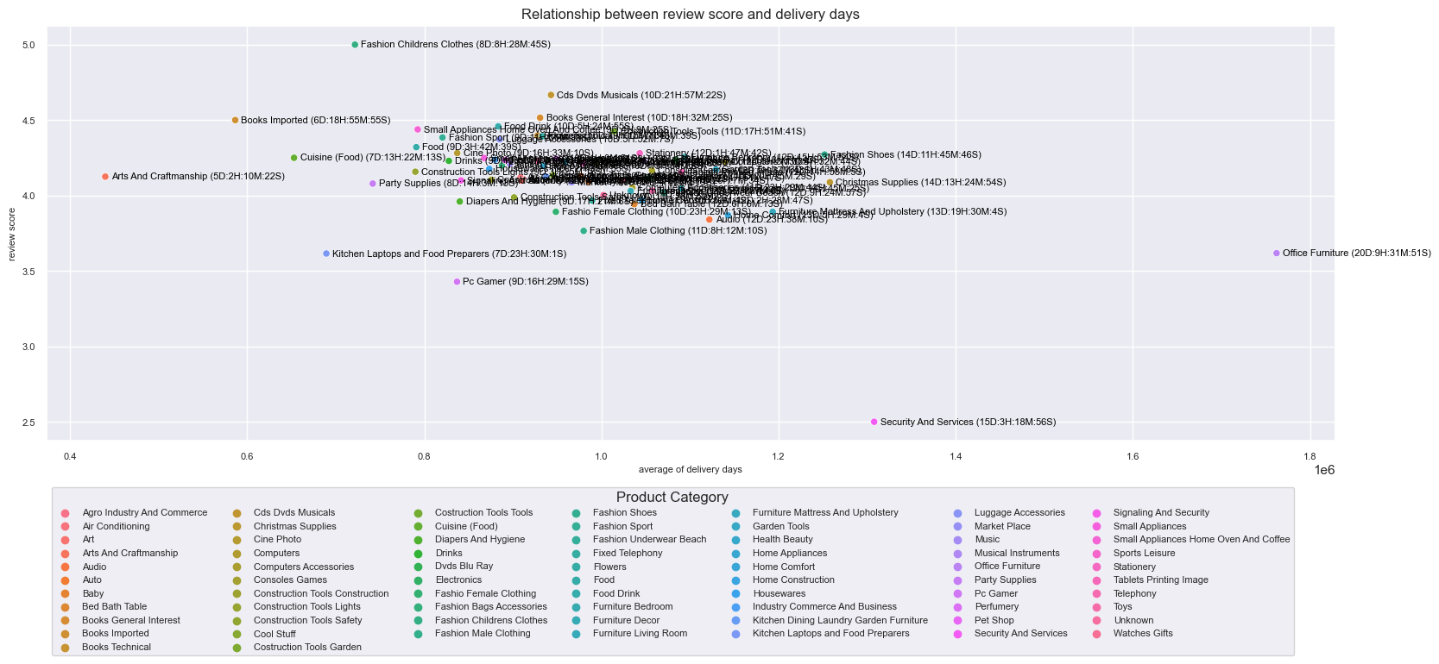
Most of the products were seen huddled between a score of 3.7 to a score of 4.5 with a total time of about 9 days to about 14 days. The product “Fashion Childrens Clothes” gets a rating of 5 with a time of 8 days, 8 hours, 28 minutes, 45 seconds. While the Security and Services product gets the lowest review score, this is due to only 1 order and also the long delivery time from the courier to the customer which is likely to cause the “Security and Services” product to get a low review score.
The “Office Furniture” product gets an average review score of around 3.6 with the longest total average time compared to other products, which reaches 20 days, 9 hours, 31 minutes, 51 seconds.

Slide 30
Suggestion
In optimizing sales performance, additional focus on marketing and distribution of goods in countries with lower sales contribution can improve market penetration and increase overall revenue.
For Olist, focusing on the market in the city of Sao Paulo is a reasonable strategy, but it also needs to consider improving customer service and effective marketing strategies to maximize market share in other cities with potential growth, such as Rio de Janeiro, Belo Horizonte, and Brasilia. Olist can also consider further expansion efforts into other untapped cities, by understanding the preferences and needs of the local market. Combining demographic data with a suitable business strategy is the key to sustainable growth.
Utilize the use of credit cards by offering loyalty programs for customers who use credit cards such as offering special discounts or getting vouchers so that customers remain loyal and subscribe by repurchasing products in olist e-commerce.
In an effort to improve time efficiency, whether it is the time of order approval, shipping and packaging. For approval, it can be automated, after the customer pays, the approval will be automatically approved. Then one of the product solutions such as “Office Furniture” that can be considered is to develop furniture products that can be disassembled like Lego, so that the packaging process is easier and delivery can be done more quickly.

Slide 31
THANKS!
CREDITS: This presentation template was created by Slidesgo, including incons by Flaticon infographics & images by Freepik

